Slide 1
AI Voice 测试全流程体系建设倡议
Initiative for the Construction of a Comprehensive Testing Process System
从经验驱动走向标准化、数据化、协同化的质量管理体系
Moving from experience driven to standardized, data-driven, and collaborative quality management systems
系统倡议汇报
System Initiative Report

Slide 2
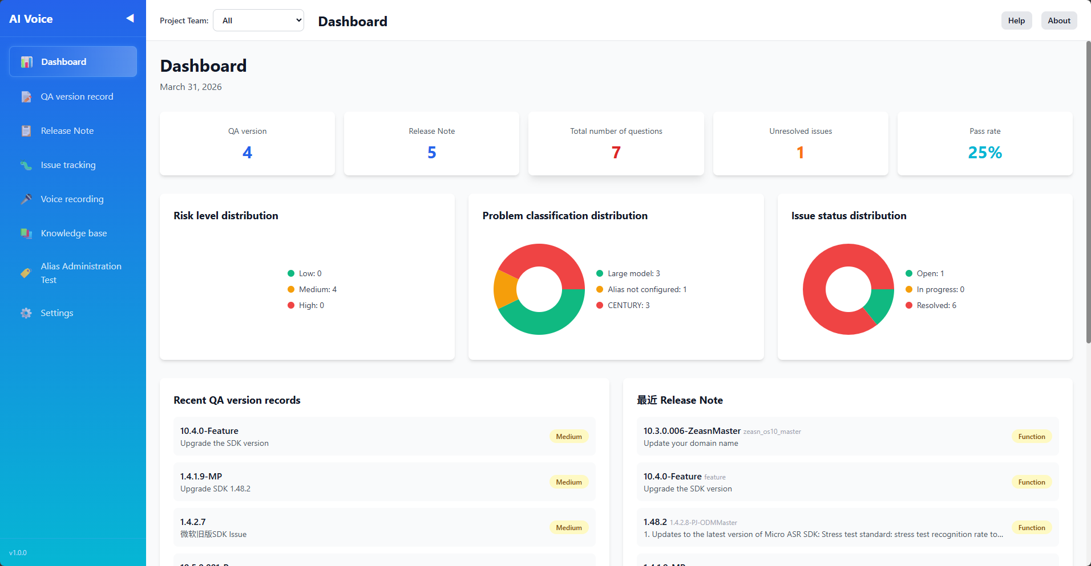
为什么要发起这项系统倡议
Why initiate this system initiative
版本频率提升后，测试范围判断越来越依赖个人经验。
After the increase in version frequency, the judgment of testing scope increasingly relies on personal experience.
客户问题记录分散，复现、归因和追踪效率不高。
Customer problem records are scattered, and the efficiency of reproduction, attribution, and tracking is not high.
测试结果沉淀不足，管理层难以快速判断风险。
Insufficient sedimentation of test results makes it difficult for management to quickly assess risks.
冒烟、语音回归、系统回归缺少统一标准，容易遗漏。
Smoke, voice regression, and system regression lack unified standards and are prone to omission.
这项倡议的本质：把分散工作沉淀成可复用、可追踪的系统。
The essence of this initiative is to precipitate dispersed work into a reusable and traceable system.

Slide 3
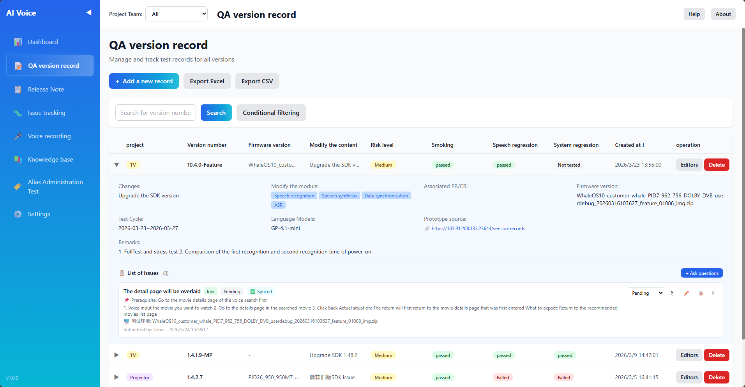
这个系统倡议的意义是什么
What is the significance of this system initiative
让测试从“人盯人”变成“流程驱动”。
Transforming testing from 'person to person' to 'process driven'.
让团队经验从“个人能力”变成“组织资产”。
Transforming team experience from 'individual abilities' to' organizational assets'.
让测试从“感觉判断”变成“数据判断”。
Transform testing from "sensory judgment" to "data judgment".
最终形成可持续优化的 AI Voice 质量保障体系。
Ultimately, a sustainable and optimized AI Voice quality assurance system will be formed.
让问题处理从“被动救火”变成“可追踪闭环”。
Transforming problem handling from 'passive firefighting' to 'traceable closed-loop'.

Slide 4
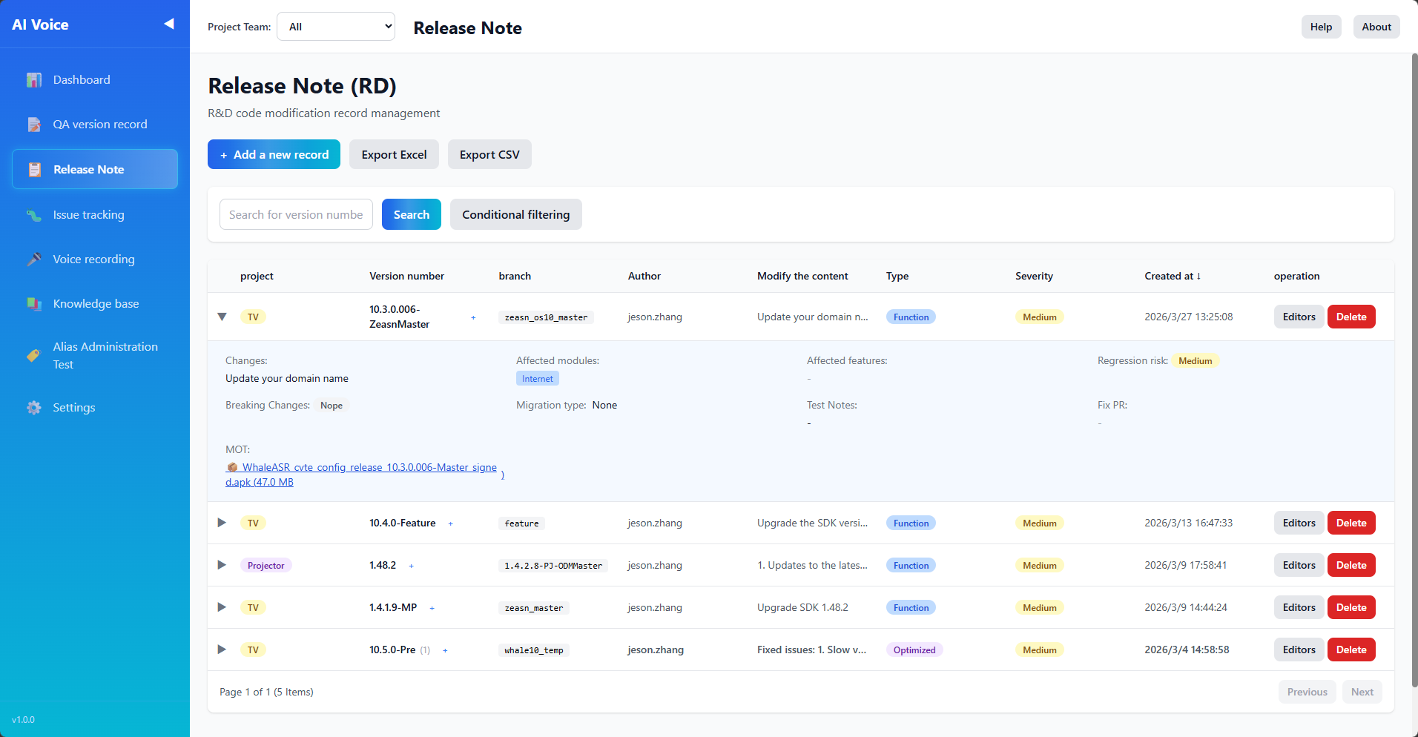
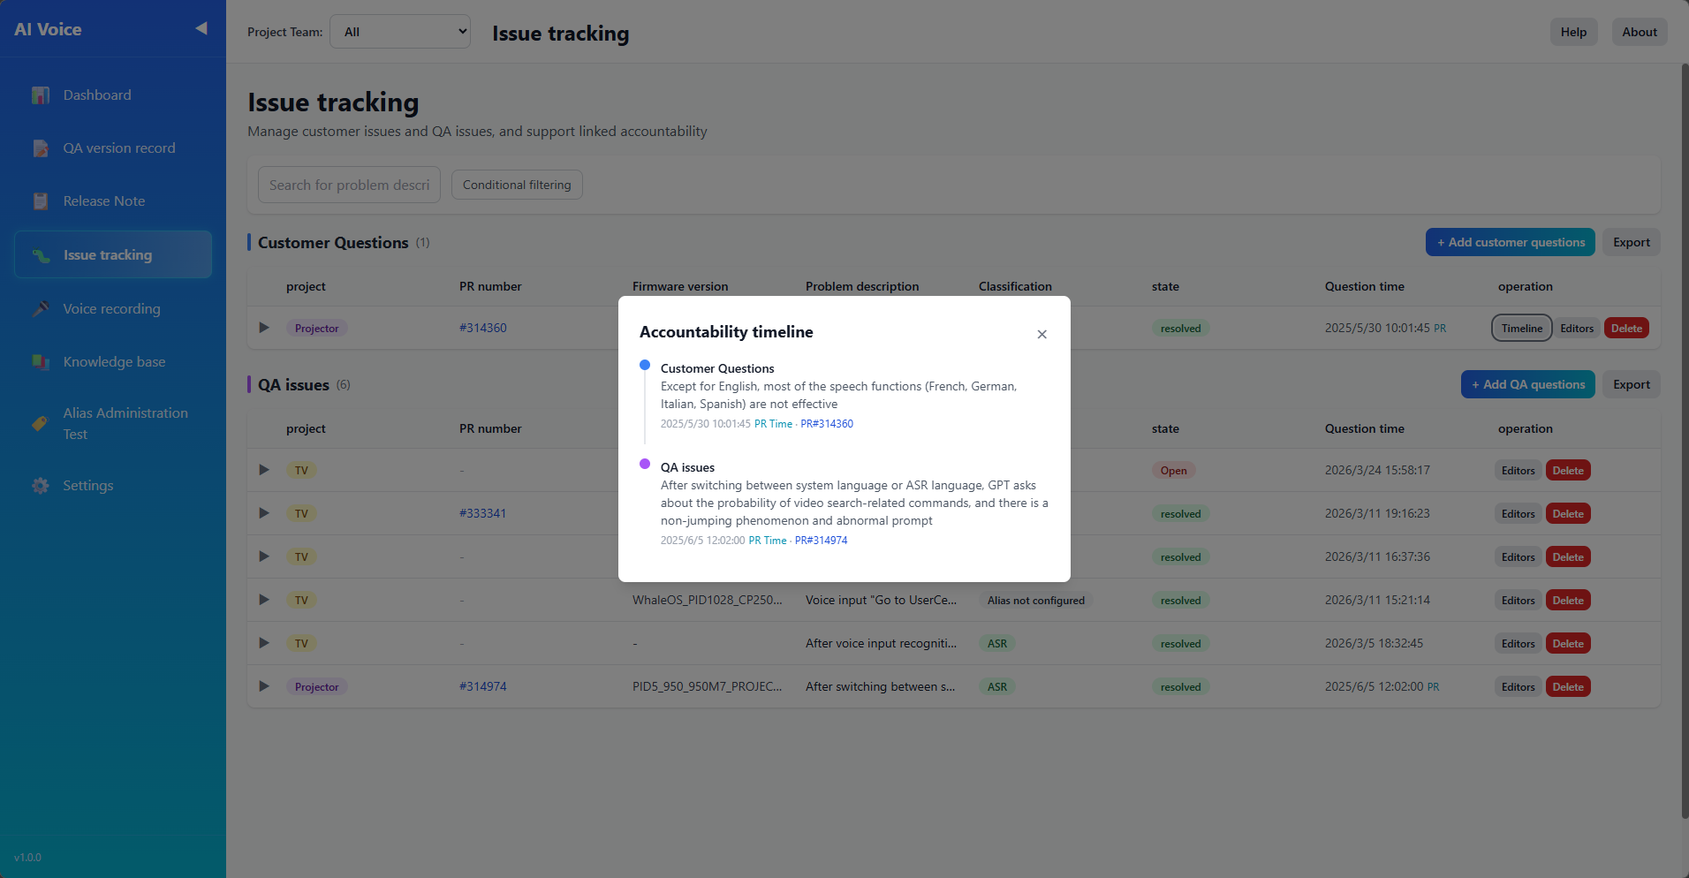
目标是什么
What is the goal
统一测试流程：版本接收、评估、回归、结论、归档。
Unified testing process: version reception, evaluation, regression, conclusion, and archiving.
提升决策效率：让测试、研发、管理层共享同一视图。
Improve decision-making efficiency: Let testing, research and development, and management share the same view.
统一记录标准：版本记录、Release Note、客户问题统一纳管。
Unified record standards: version records Release Note、 Unified management of customer issues.
沉淀长期资产：每次测试和每个问题都可复用。
Accumulate long-term assets: reusable for every test and every issue.
提升测试效率：减少重复劳动和漏测风险。
Improve testing efficiency: reduce the risk of repetitive labor and missed testing.

Slide 5
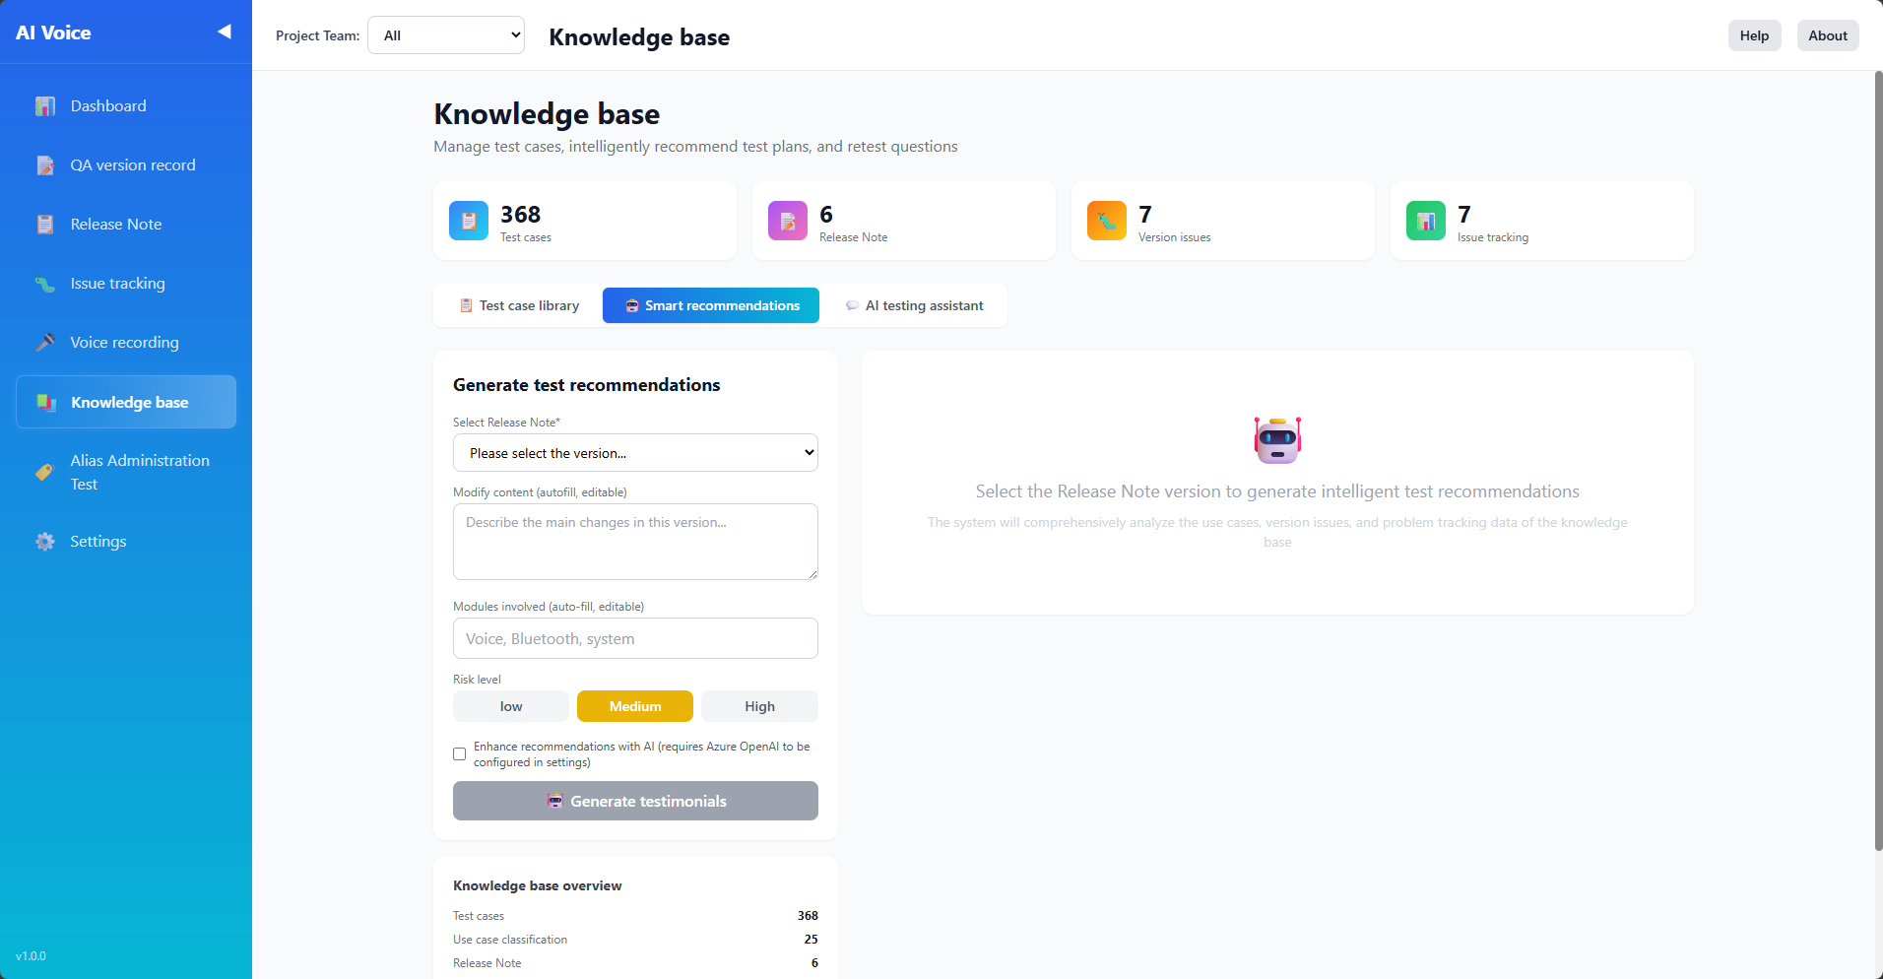
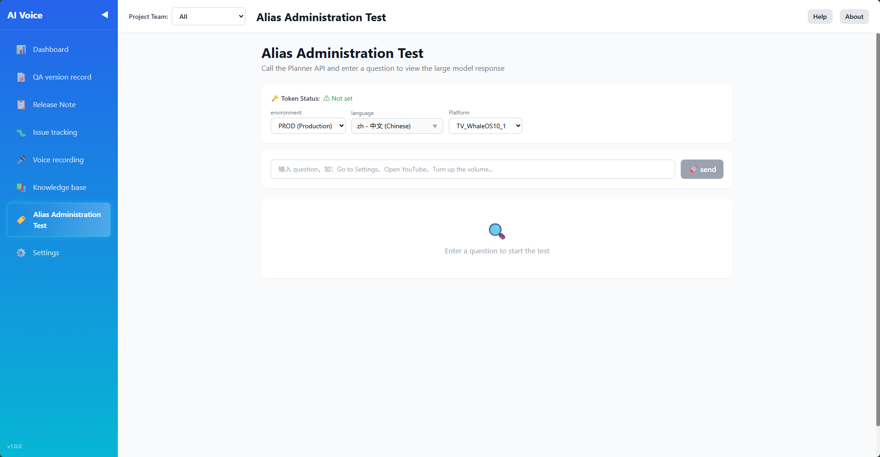
对我们有什么好处
What benefits does it bring to us
对测试：流程更清晰，范围更聚焦，结果更可追溯。
For testing: clearer process, more focused scope, and more traceable results.
对团队：新人更容易上手，经验不再依赖个别人。
For the team: Newcomers are easier to get started with, and experience no longer depends on individuals.
对研发：更快定位版本、模块和问题场景，沟通成本更低。
For R&D: Faster positioning of versions, modules, and problem scenarios, with lower communication costs.
对组织：逐步形成可复制、可扩展的质量运营能力。
For organizations: gradually develop replicable and scalable quality operation capabilities.
对管理：直接看到通过率、高风险版本和未解决问题。
For management: directly see the pass rate, high-risk versions, and unresolved issues.

Slide 6
谢谢
Thank you
Q&A

